Slide 1
Project Solutions of AIR CARGO ANALYSIS

Slide 2
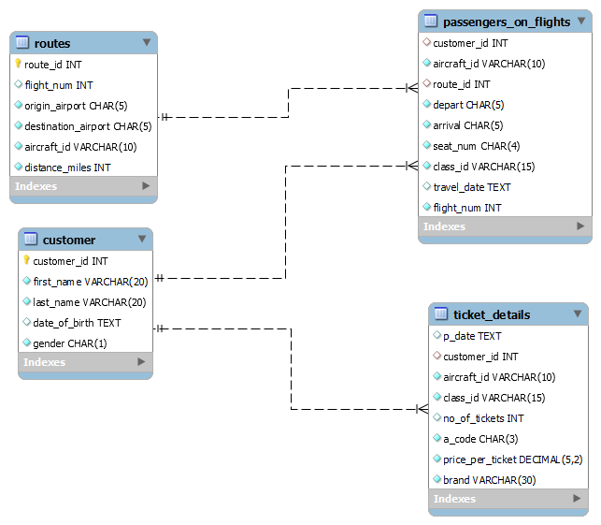
Answer of Ques. 1

Slide 3
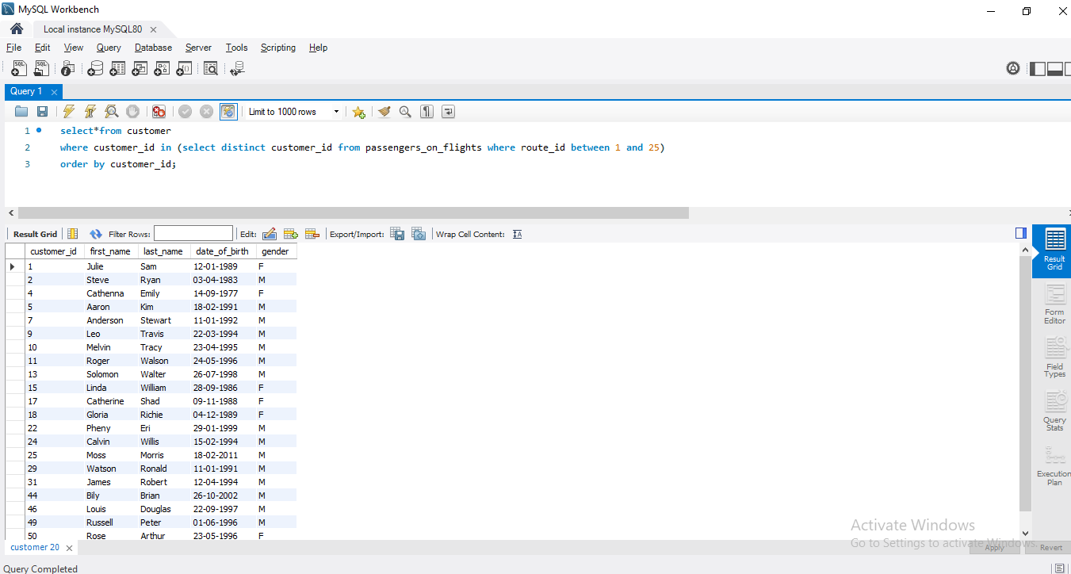
Answer of Ques. 2

Slide 4
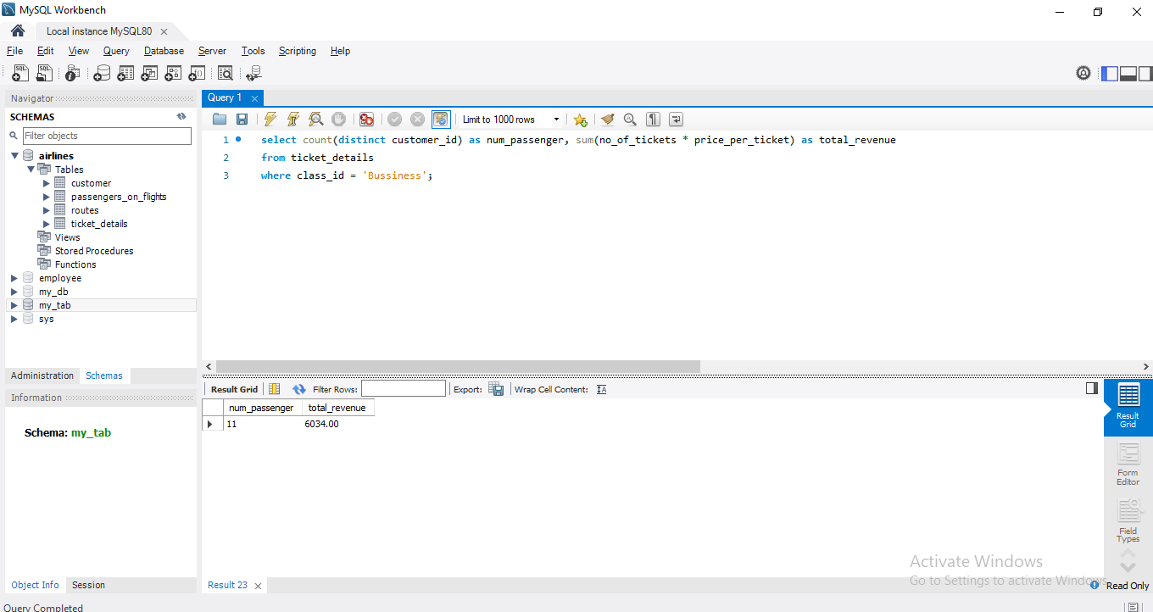
Answer of Ques. 3

Slide 5
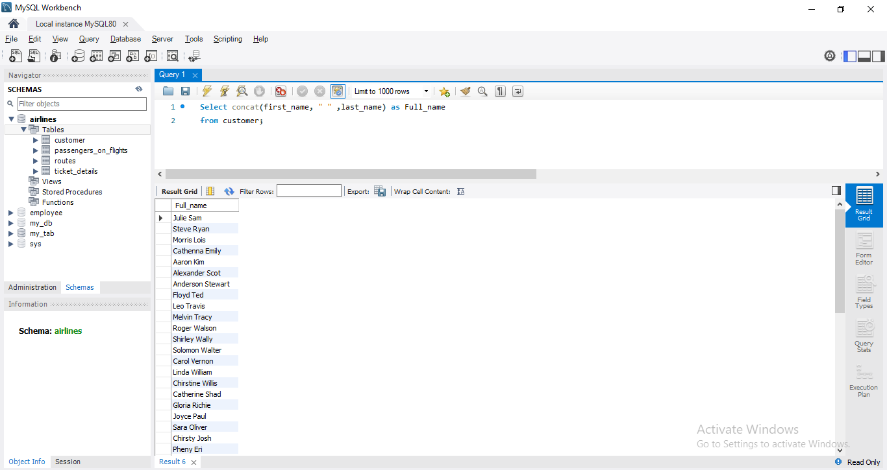
Answer of Ques. 4

Slide 6
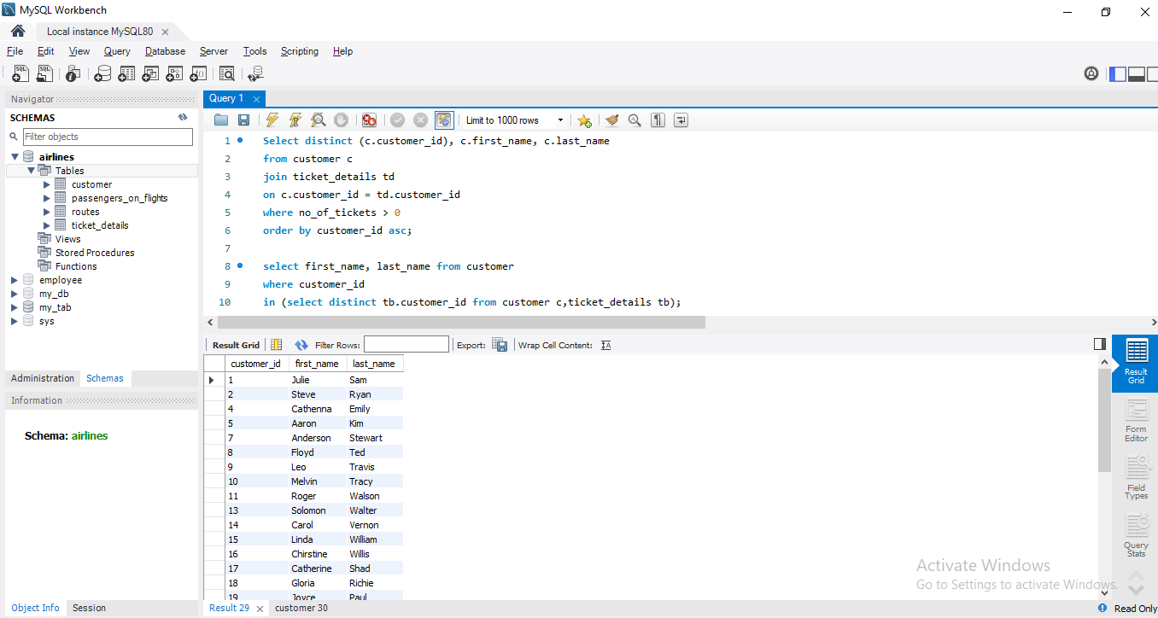
Answer of Ques. 5.1

Slide 7
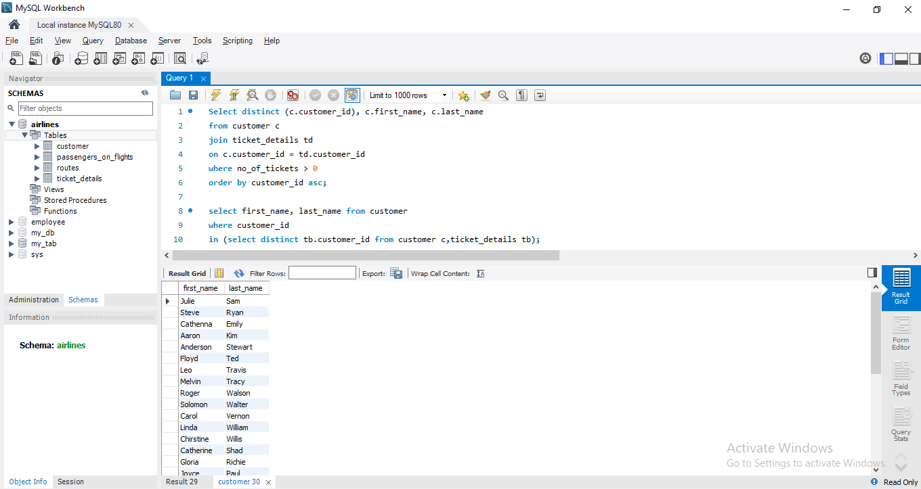
Answer of Ques. 5.2

Slide 8
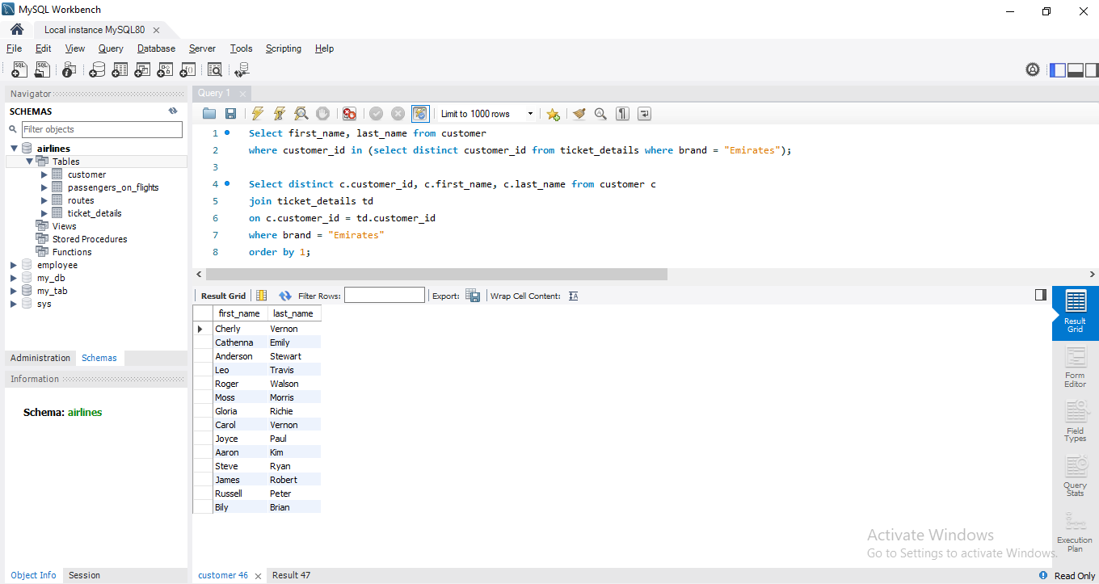
Answer of Ques. 6.1

Slide 9
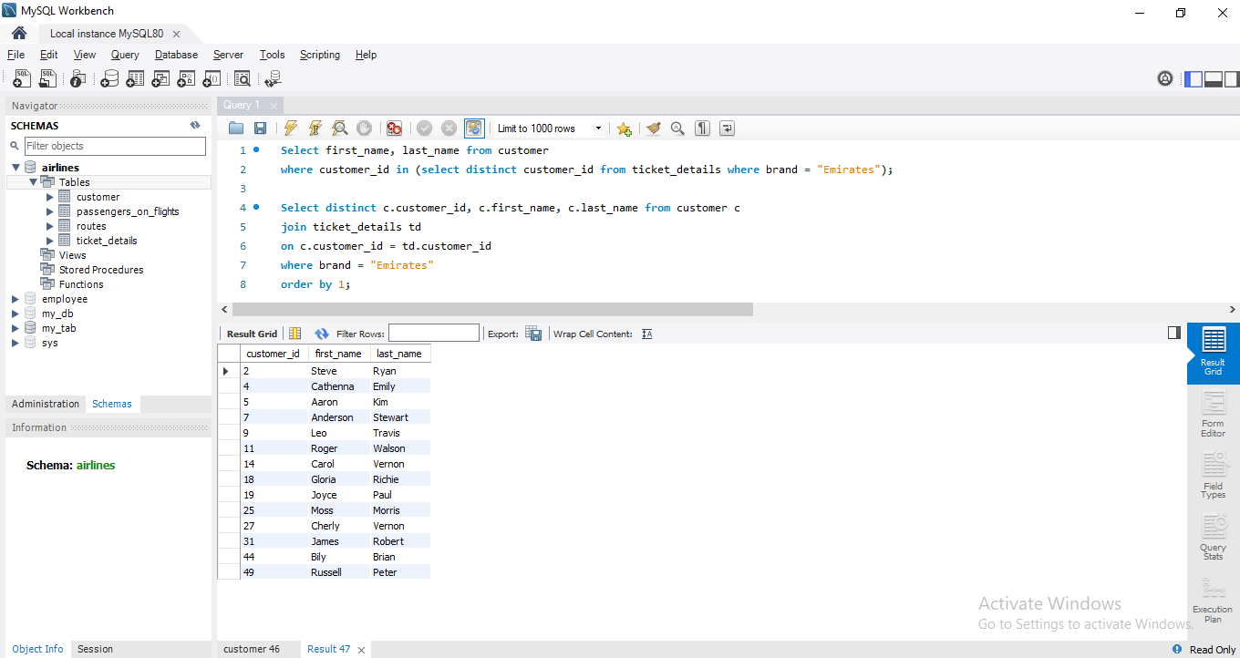
Answer of Ques. 6.2

Slide 10
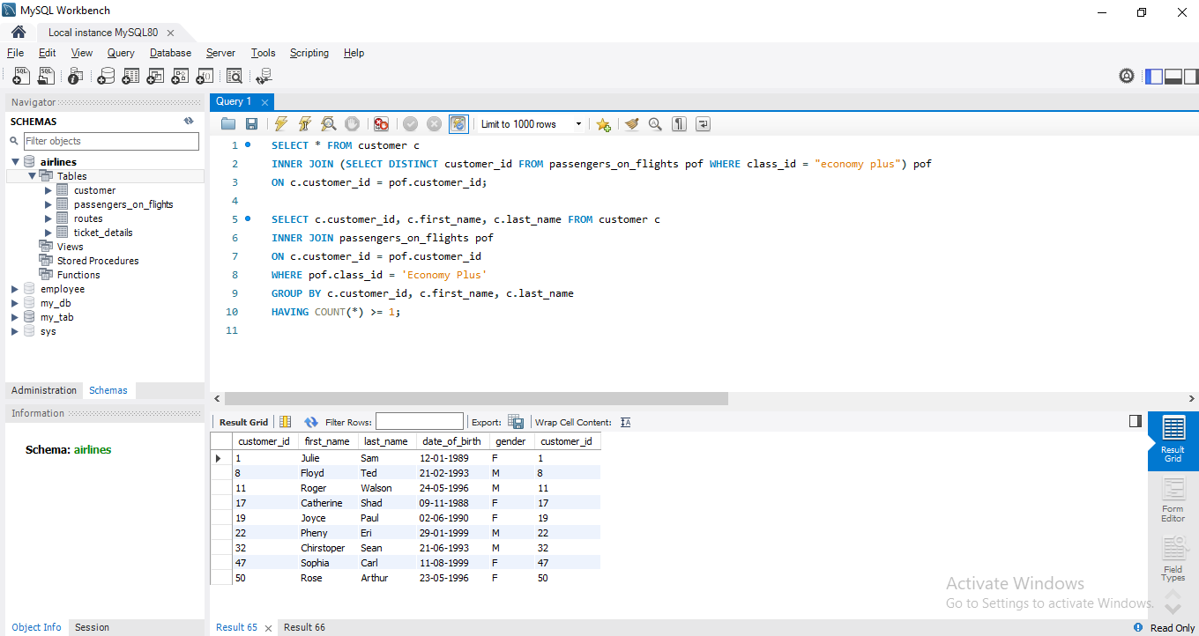
Answer of Ques. 7.1

Slide 11
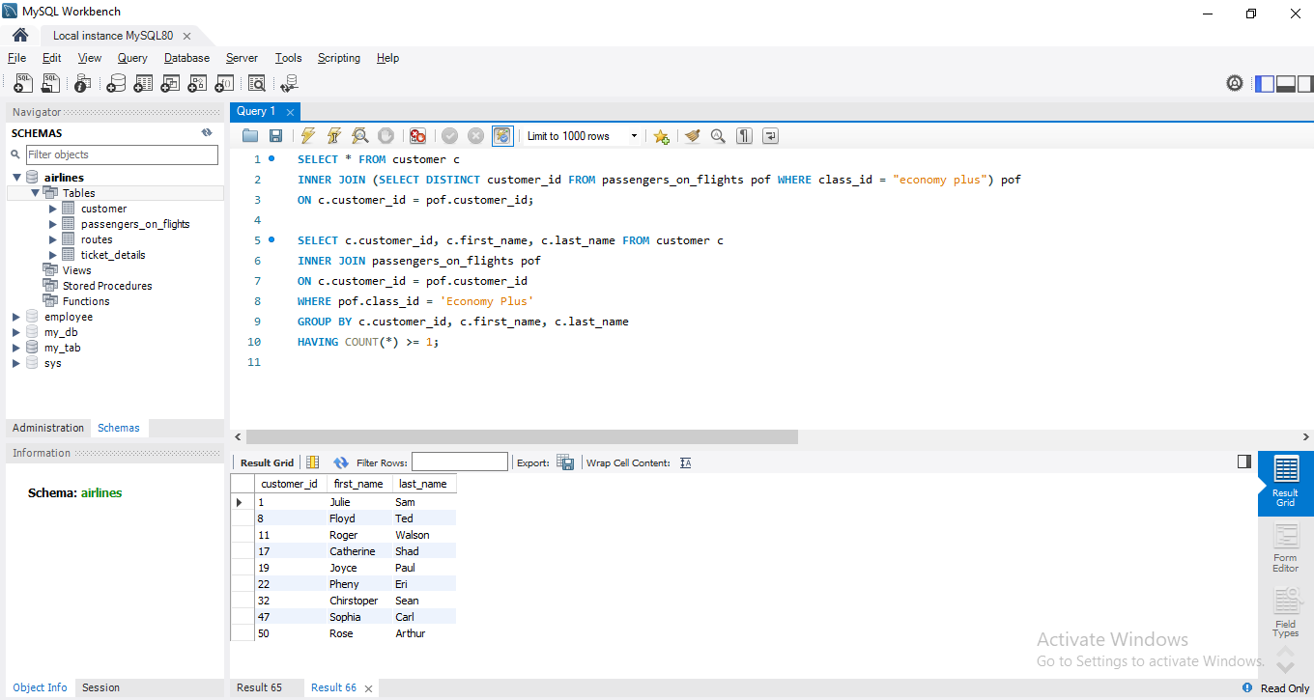
Answer of Ques. 7.2

Slide 12
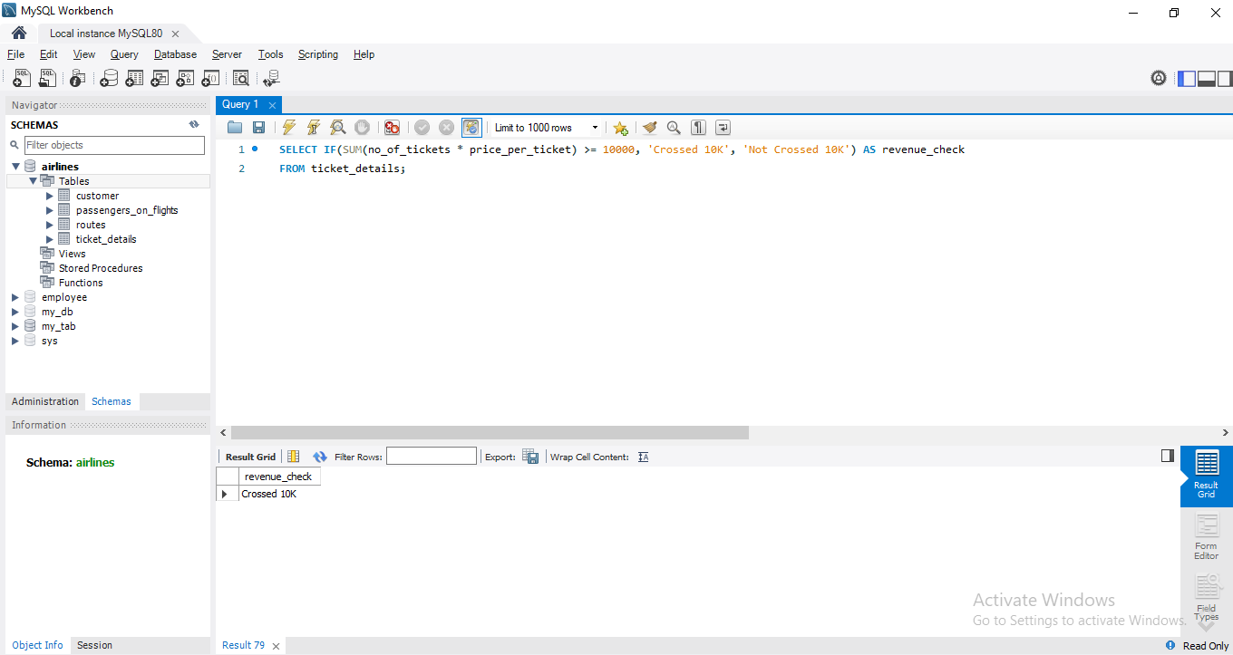
Answer of Ques. 8

Slide 13
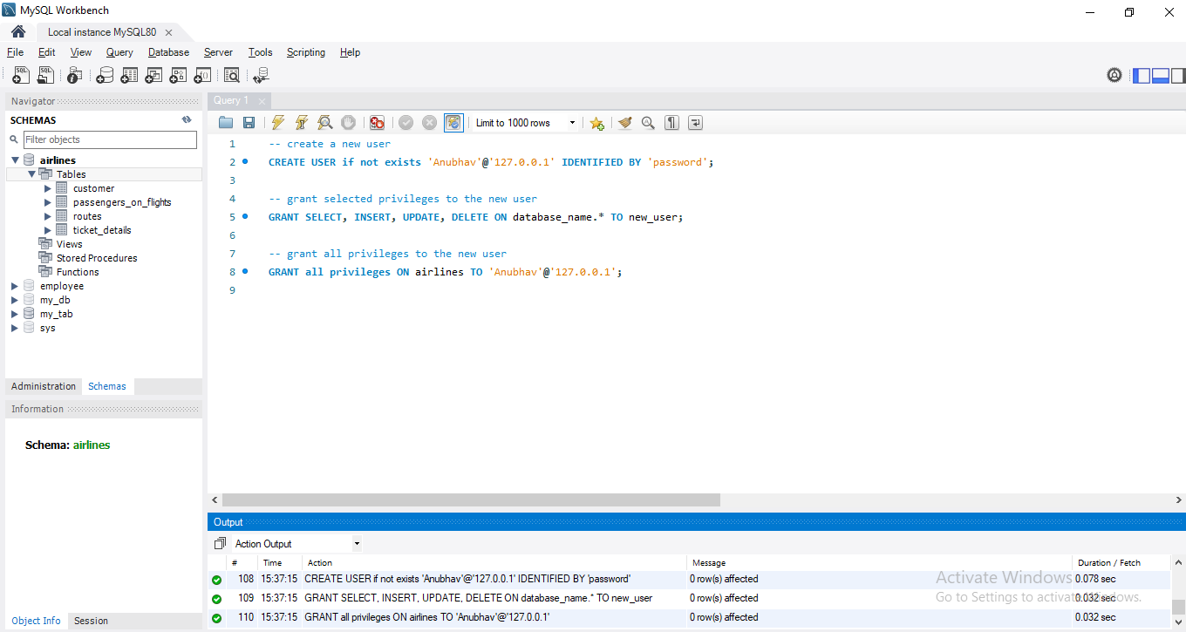
Answer of Ques. 9

Slide 14
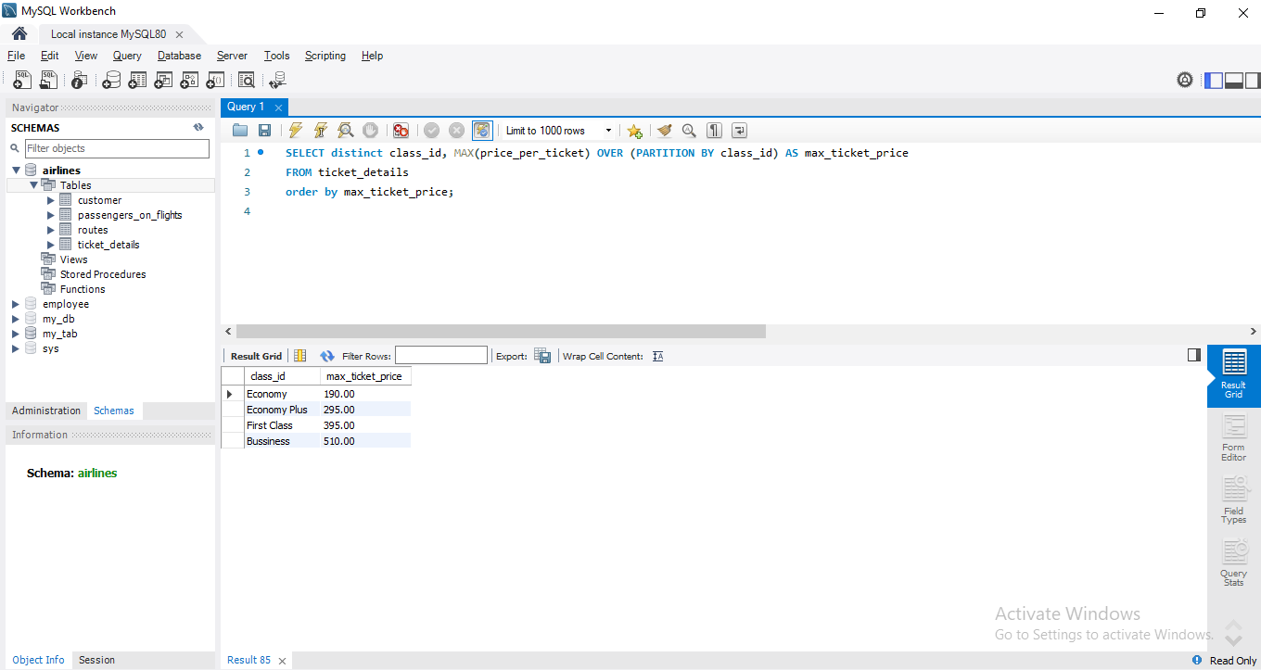
Answer of Ques. 10

Slide 15
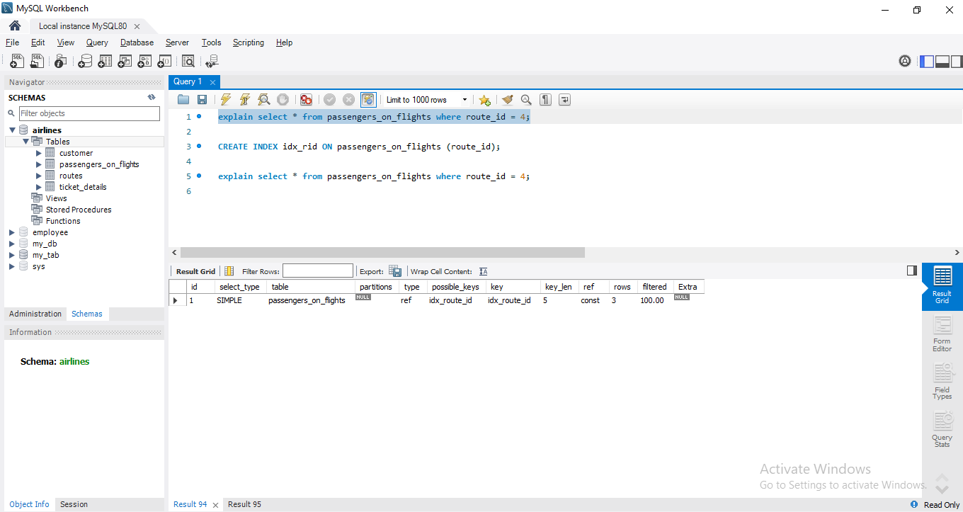
Answer of Ques. 11

Slide 16
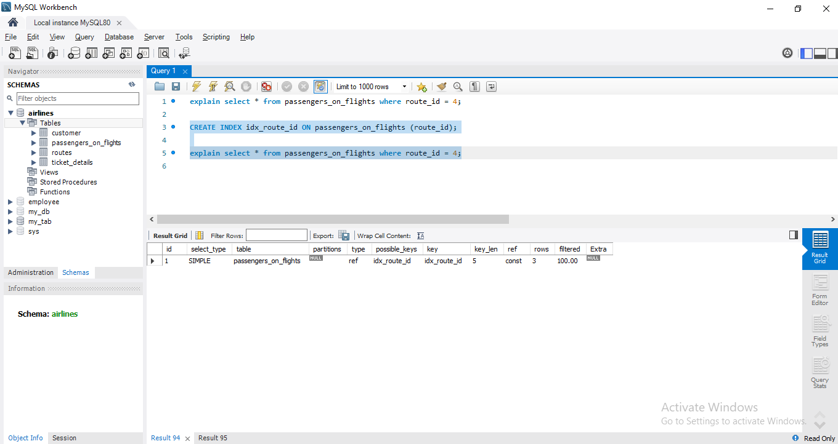
Answer of Ques. 12

Slide 17
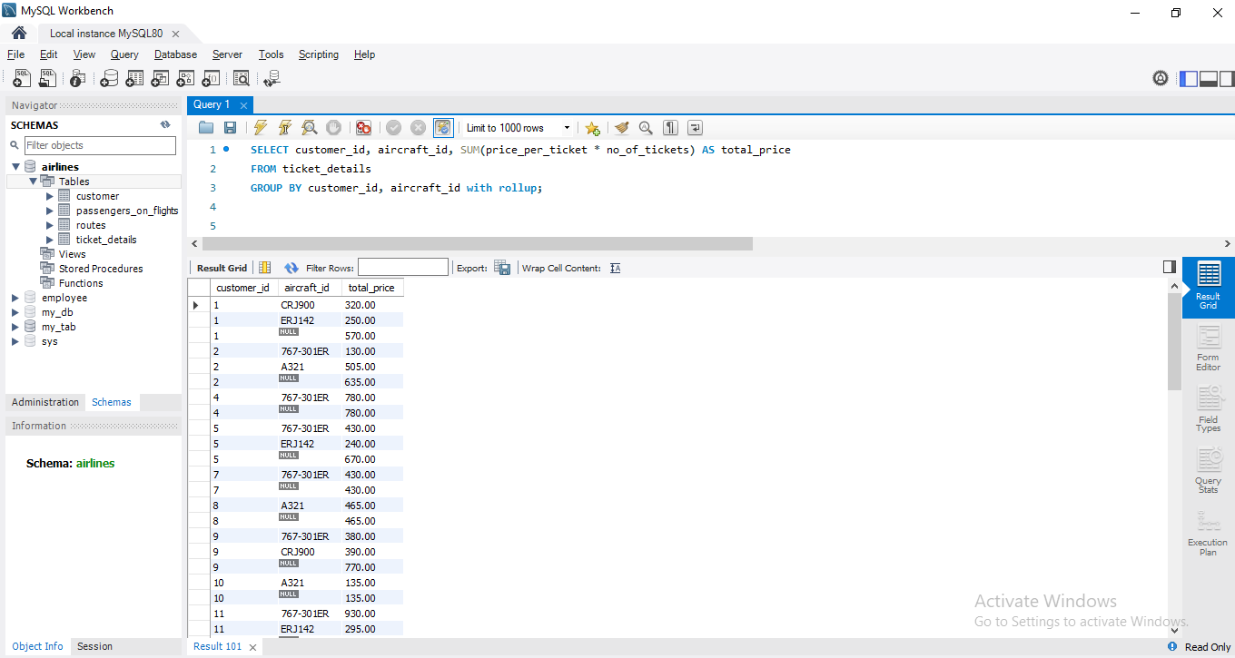
Answer of Ques. 13.1

Slide 18
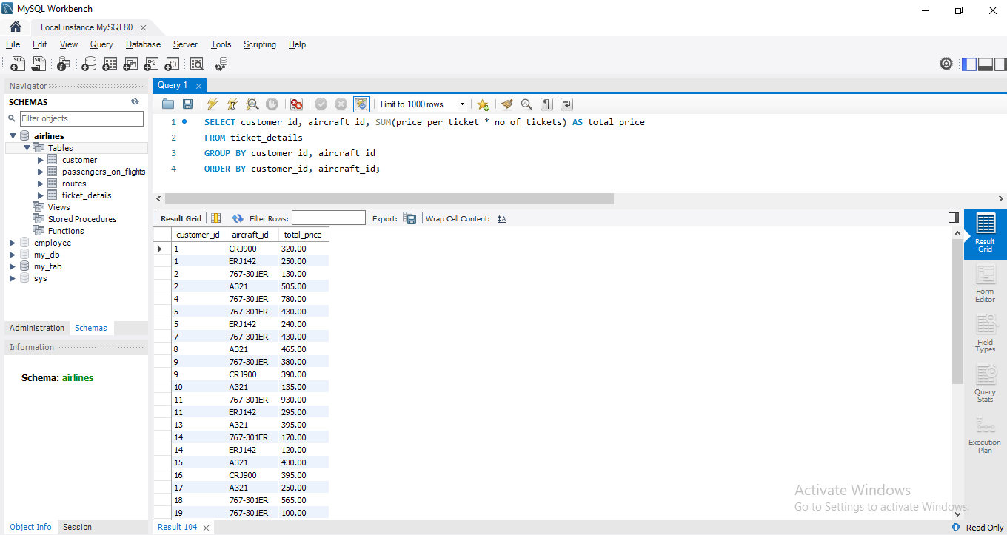
Answer of Ques. 13.2

Slide 19
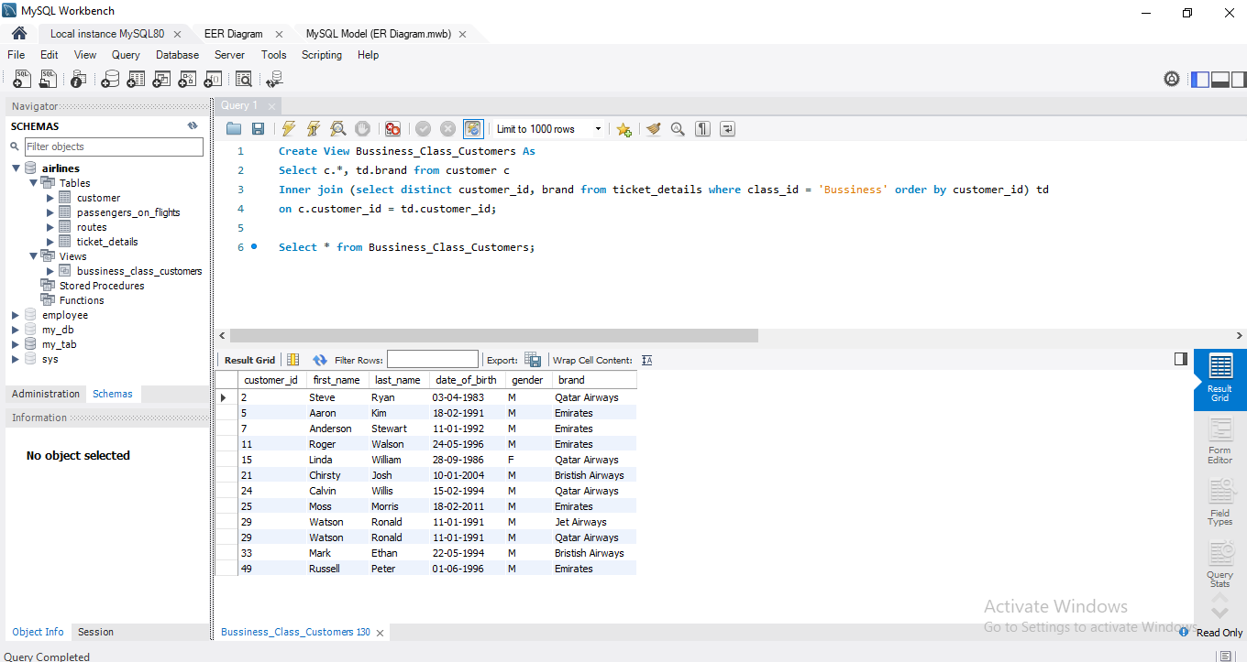
Answer of Ques. 14

Slide 20
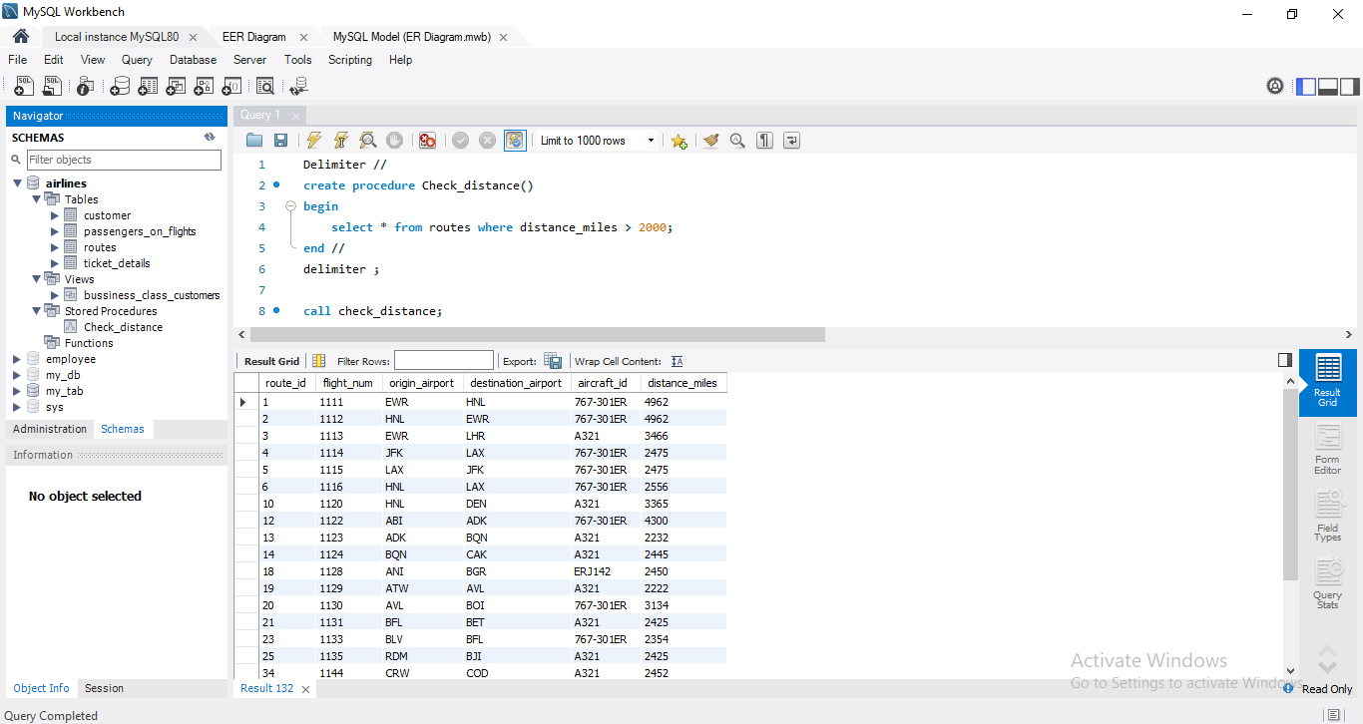
Answer of Ques. 15

Slide 21
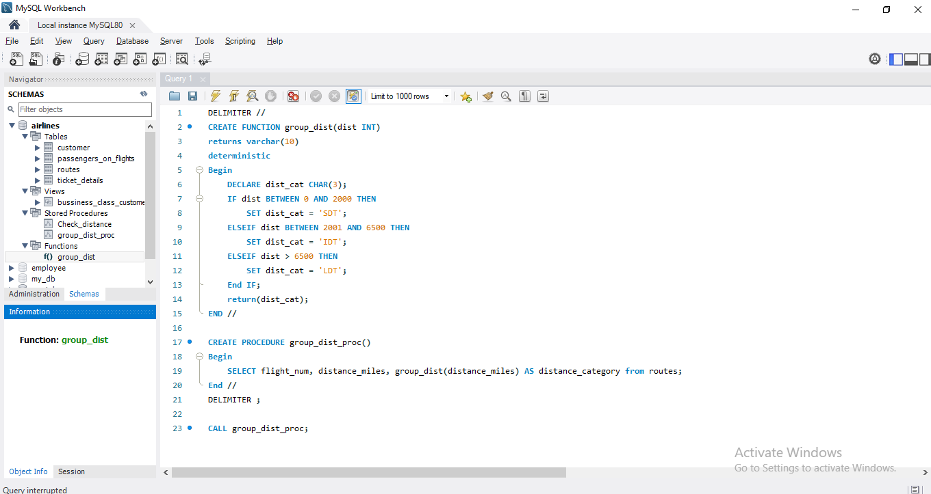
Answer of Ques. 16 (Query)

Slide 22
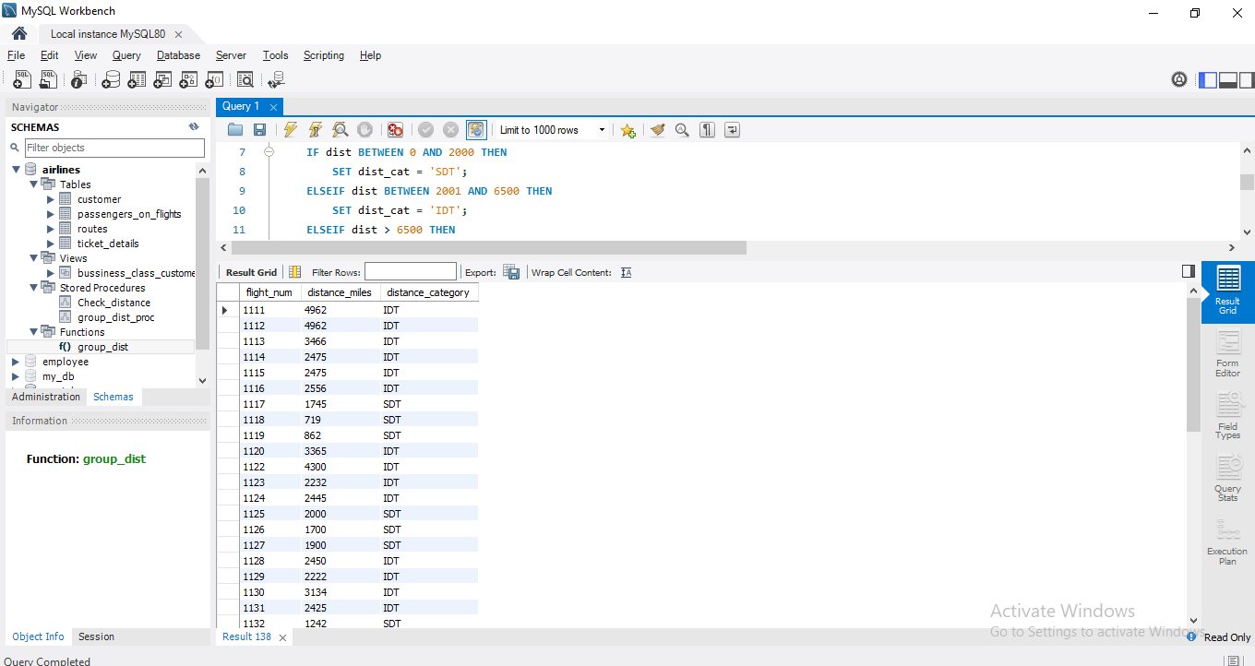
Answer of Ques. 16 (Output)

Slide 23
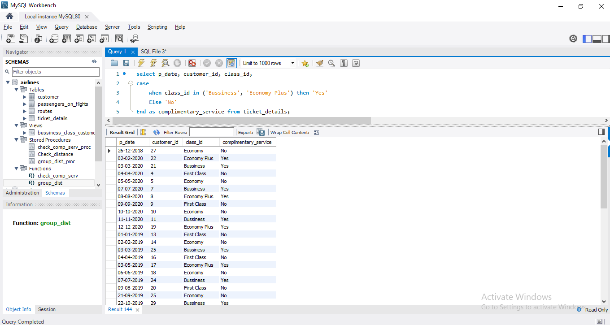
Answer of Ques. 17 (Query Without create procedure)

Slide 24
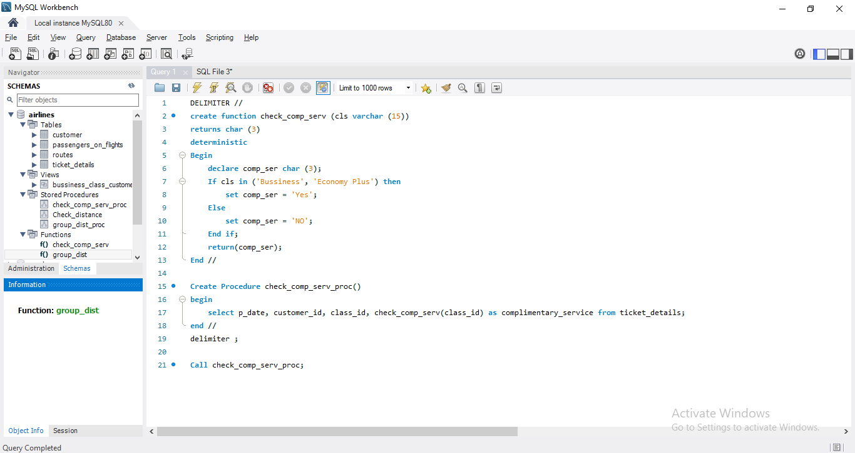
Answer of Ques. 17 (Query of Create Procedure)

Slide 25
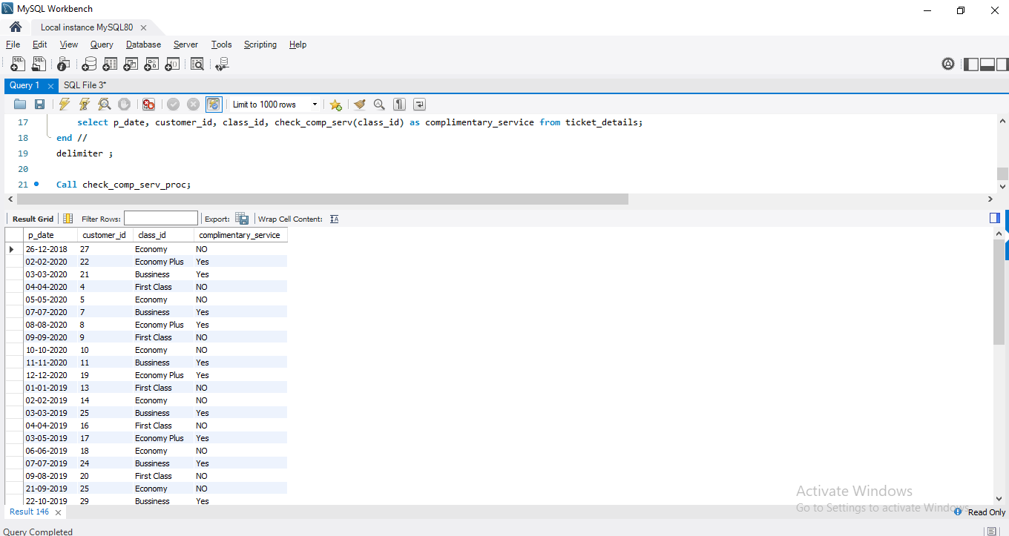
Answer of Ques. 17 (Output of Create Procedure)

Slide 26
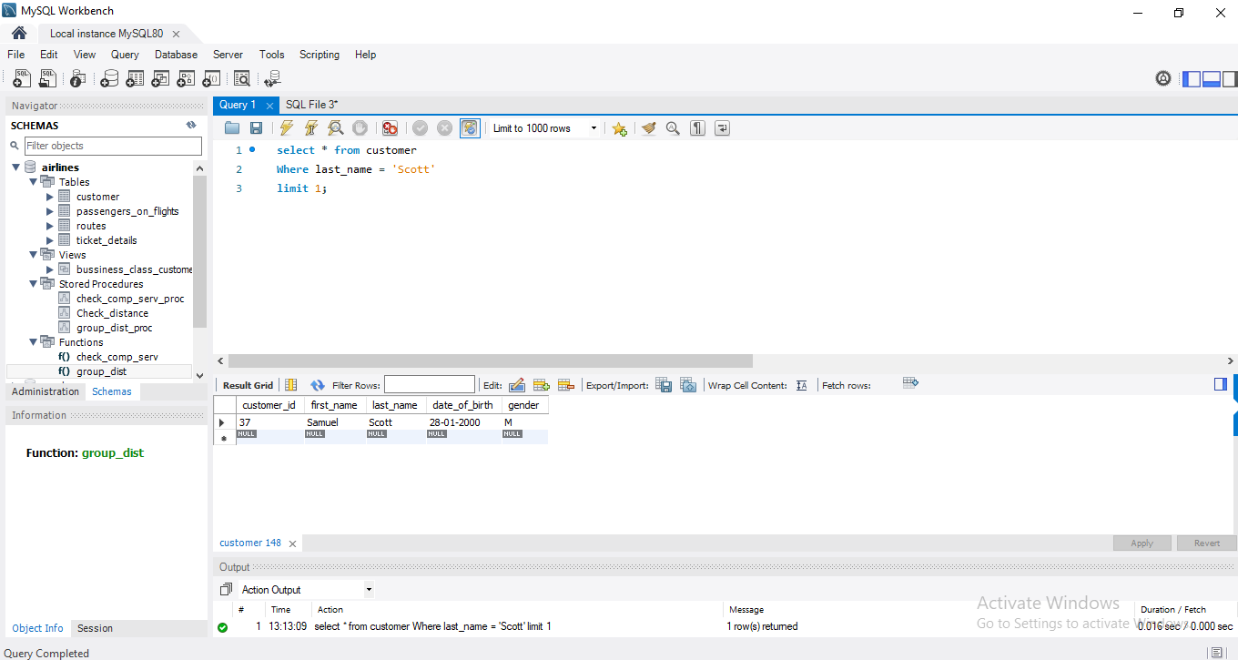
Answer of Ques. 18

Slide 27

Project Outcome
This project is designed to analyze the busiest route to increase the number of aircraft required.
It also helps to identify the regular customers to provide offers and prepare an analysis of the ticket sales.
You should be able to ensure the company improves its operability and becomes more customer-centric and appealing to travelers.

